Slide 1

Predicting DCU losses from defaulted credit cards : LGD forecasting
Presentation by:
Praachi Ganjawalla
Riya Mehta
Shashwat Shah
Vihar Mehta
Instructor: Luvai Motiwalla
Professor: Nichalin Summerfield
Sponsor(s): Andre Mittag, Michael Wile

Slide 2
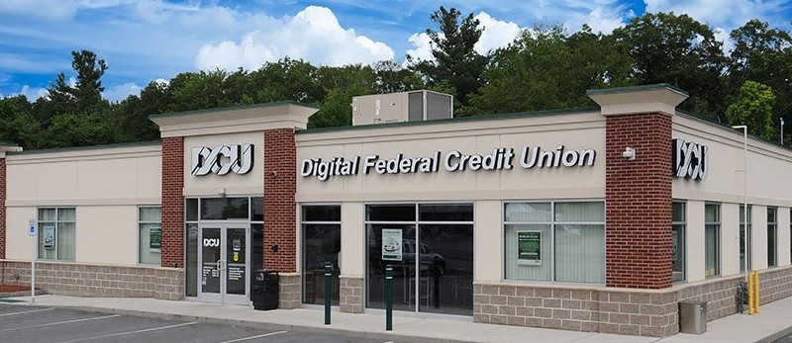
About DCU:
Digital Federal Credit Union ( DCU) is the largest credit union in New England.
DCU offers consumer and banking services including mortgage, auto loan Credit card (visa), and Business Banking.
It also offers Non-Banking services like DCU Insurance, DCU Realty.
This project focuses on predicting and identifying the key factors related to "Loss Given Default" (LGD%) of credit card accounts.
MIST.6490 Capstone Projects, Fall 2023, Prof. Motiwalla
2

Slide 3
Table of Contents: CRISP-DM methodology (Cross Industry Standard Process for Data Mining).
Business understanding
Data understanding
Data preparation
Modelling
Evaluation
Project Objectives & Scope
Data Cleaning/Preparation/Overview
Descriptive Analytics
Predictive Modeling Methodology
Results
Conclusions
MIST.6490 Capstone Projects, Fall 2023, Prof. Motiwalla
3

Slide 4
Project Objectives & Scope:
Past due 90 days
Recovery
Credit Card members
Default members
Balance - Recovery
= Losses ($)
Loss / Balance = LGD (%)
Model 1
Recovery
Yes / No
Model 2
Recovery Amount ($)
Calculate predicted LGD (%)
If Yes, then
Our Project Scope
If No, then 100% loss
MIST.6490 Capstone Projects, Fall 2023, Prof. Motiwalla
4

Slide 5

Data Cleaning
29,801 rows x 43 columns​
Input: Raw data
(records captured at end of each month)
22,168 rows x 37 columns
Credit card accounts with the origination date between , 01/31/2011 to 12/31/2022
Output: Cleaned data
MIST.6490 Capstone Projects, Fall 2023, Prof. Motiwalla
5

Slide 6
Data Overview:
The final data contains 22,168 rows and 37 columns, respectively ​
Input- 37 Columns which are as follows:​
Charge Off Amount ($) | Product Type (DCU Visa, DCU Rewards Visa)
Credit Card Limit ($) | Negative Share Balance (Yes, No)
Balance at Default ($) | Interest Accrued (0 – 853.26)
Credit Score (375-818) | Seasoned over 2 years (Yes, No)
Time Delinquent in Days (30, 60 and 90) | State: New England & others
Member Type (Business, Personal) | Others
Bankruptcy Flag (Yes, No)
Outcome - Recovery (Y/N), Recovery ($), LGD (%)
MIST.6490 Capstone Projects, Fall 2023, Prof. Motiwalla
6

Slide 7
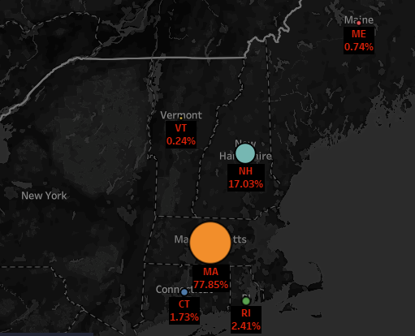
Descriptive Analysis Number of credit card defaults from New England and Non- New England states
Distribution of Default Credit Card Accounts by Location (%)

Slide 8
Visualizing Membership Levels: A Slice of Insights from Refined Data
Descriptive Analysis​

Slide 9
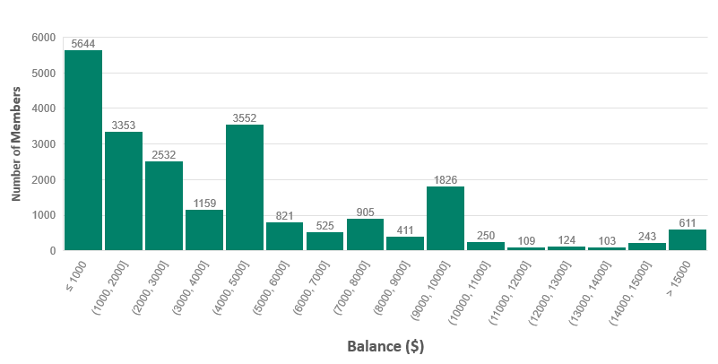
Descriptive Analysis Distribution of Balance at Default

Slide 10
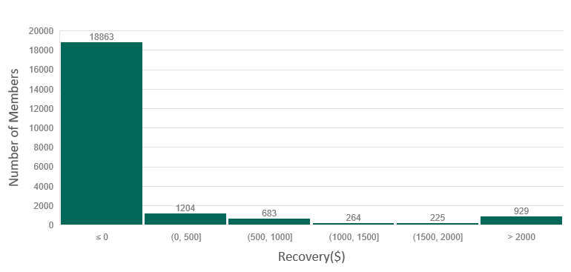
Descriptive Analysis Distribution of Recovery($)

Slide 11
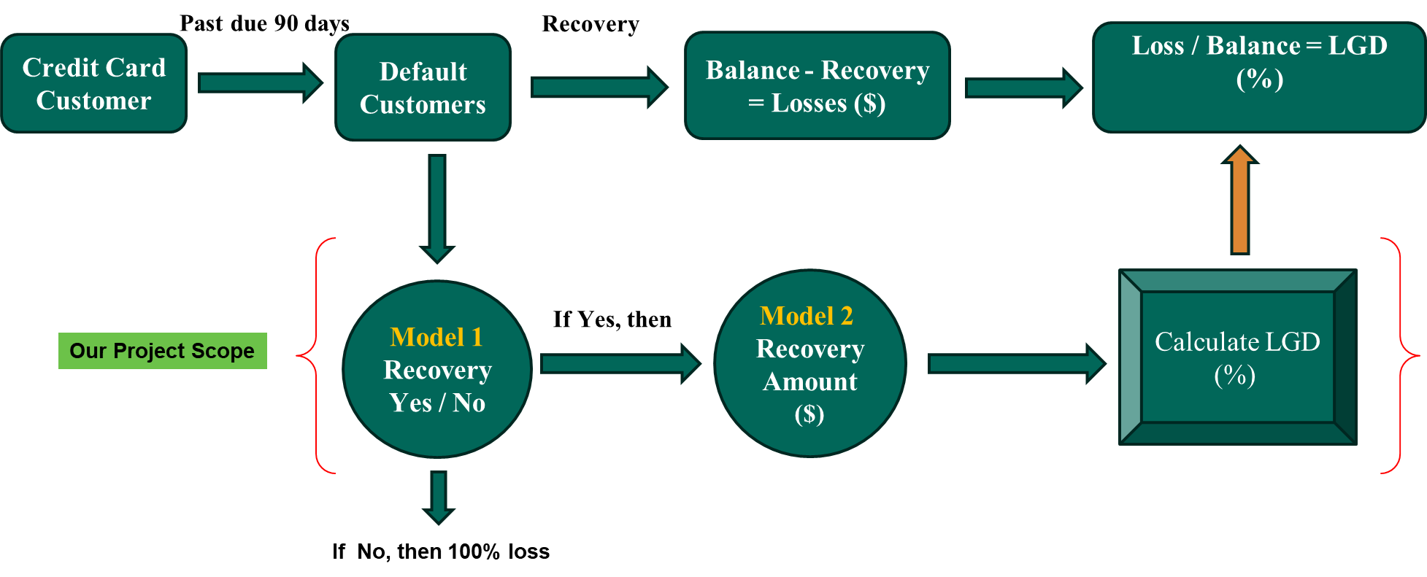
Methodology
Removing multicollinearity using VIF
Cross Validation (2013-2017 for training and 2018-2022 for testing)
Model 1 : Logistic regression - Recovery (Yes/No)
Model 2: Linear regression – Recovery amount ($), LGD(%)

Slide 12
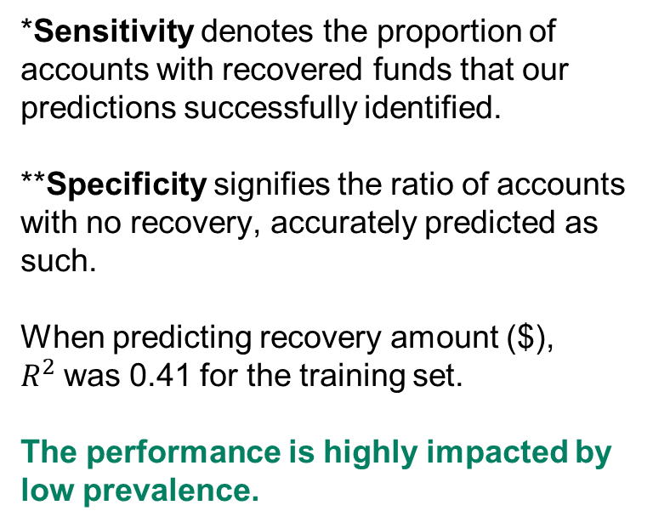
Model 1: Logistic Regression
Results
 | Training Performance 2013 – 2017 | 2018-2020 Q1 | 2020 Q2-Q4 | 2021 | 2022
Prevalence | 0.15 | 0.17 | 0.10 | 0.06 | 0.05
Sensitivity* | 0.33 | 0.29 | 0.29 | 0.39 | 0.34
Specificity** | 0.79 | 0.79 | 0.79 | 0.73 | 0.75
Accuracy | 0.72 | 0.70 | 0.73 | 0.71 | 0.73
*Sensitivity denotes the proportion of accounts with recovered funds that our predictions successfully identified.
**Specificity signifies the ratio of accounts with no recovery, accurately predicted as such.
When predicting recovery amount ($), $R^{2}$was 0.41 for the training set.
The performance is highly impacted by low prevalence.
Model 2: Linear Regression
 | Training Performance 2013 - 2017 | 2018-2020 Q1 | 2020 Q2-Q4 | 2021 | 2022
MSE | 0.138 | 0.158 | 0.152 | 0.160 | 0.121
R-squared | 0.043 | -0.139 | -0.023 | 0.046 | 0.073
MSE and $R^{2}$ were measured on LGD(%).

Slide 13
Important features
The following factors have the most impact on our target variable:
Model 1 - Logistic Regression
Limit (-)
Credit_score (-)
Bankruptcy_flag (+)
Has_direct_dep (-)
Neg_share_balance (-)
New_England (-)
Diff_open_date_credit_score (+)
Note:
(+) means that the higher the variable's value, the higher the chance of recovery.
(-) means that the higher the variable's value, the lower the chance of recovery.
Model 2 - Linear Regression
Limit (+)
Times_Delq_30_days (+)
Times_Delq_90_days (-)
New_England (+)
Balance (+)
Note:
(+) means that the higher the variable's value, the higher the recovery $ amount.
(-) means that the higher the variable's value, the lower the recovery $ amount.

Slide 14
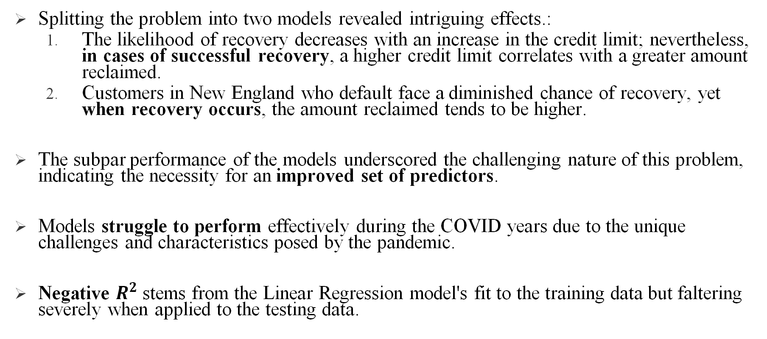
Conclusion
Splitting the problem into two models revealed intriguing effects.:
The likelihood of recovery decreases with an increase in the credit limit; nevertheless, in cases of successful recovery, a higher credit limit correlates with a greater amount reclaimed.
Customers in New England who default face a diminished chance of recovery, yet when recovery occurs, the amount reclaimed tends to be higher.
The subpar performance of the models underscored the challenging nature of this problem, indicating the necessity for an improved set of predictors.
Models struggle to perform effectively during the COVID years due to the unique challenges and characteristics posed by the pandemic.
Negative $R^{2}$stems from the Linear Regression model's fit to the training data but faltering severely when applied to the testing data.

Slide 15




Key Takeaways
Data pre-processing: Meticulous data preprocessing in our capstone project has been a profound learning experience. From grappling with real-world data challenges to collaboratively implementing advanced statistical models.
Skills: Leveraged Python, Excel and Tableau extensively for making data-driven decisions.
Collaboration: Grateful for this learning experience to work with DCU with their constant support helping us learn through mistakes, we achieved more together than we ever could alone.
Prospects: DCU can leverage this analysis to enhance its credit risk management strategies.

Slide 16
Thank you!
Instructor: Luvai Motiwalla
Professor: Nichalin Summerfield
Sponsor(s): Andre Mittag, Michael Wile

Slide 17
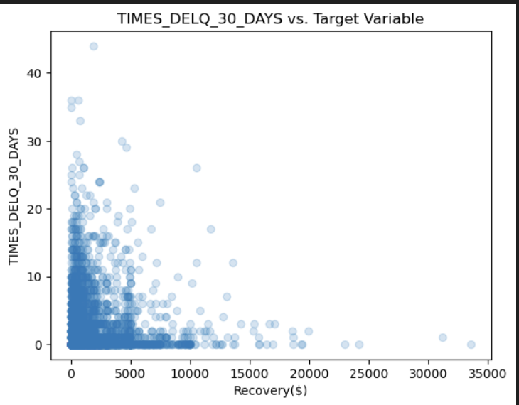
Appendix

Slide 18
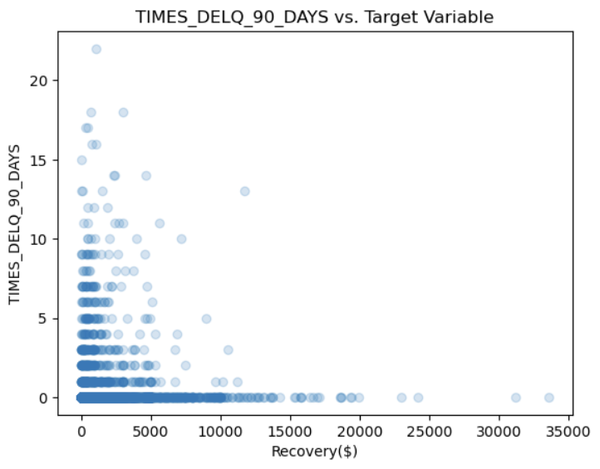
Appendix

